Slide 1

PAY to WIN!
PAID team
Zihao Jia, Mina Son, Philseok Lee

Slide 2
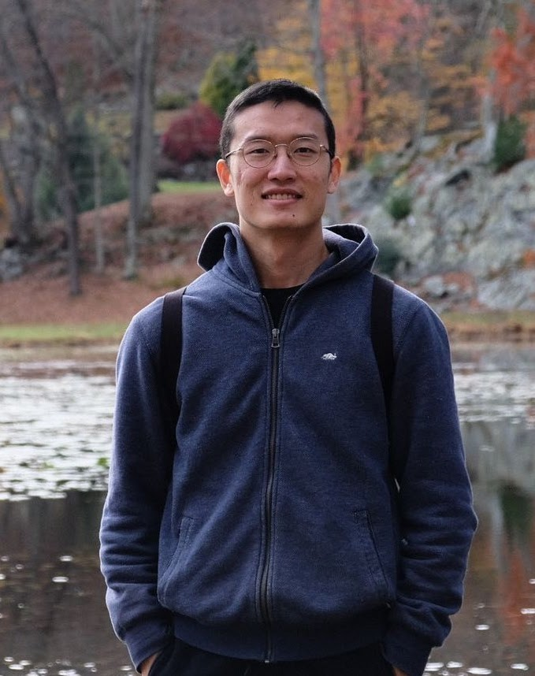
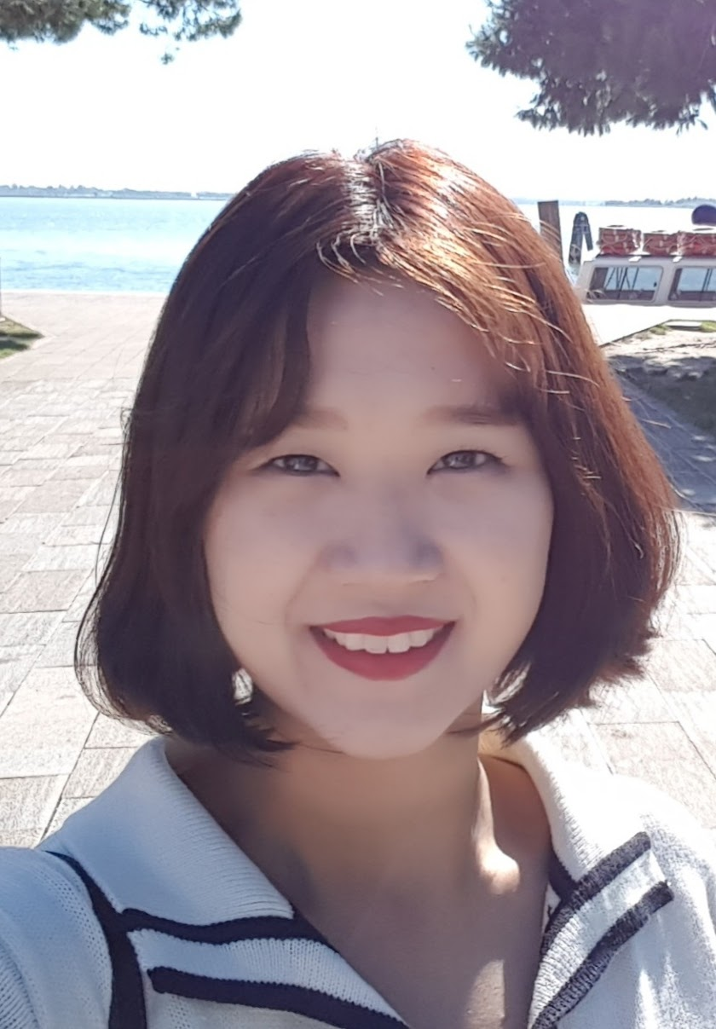
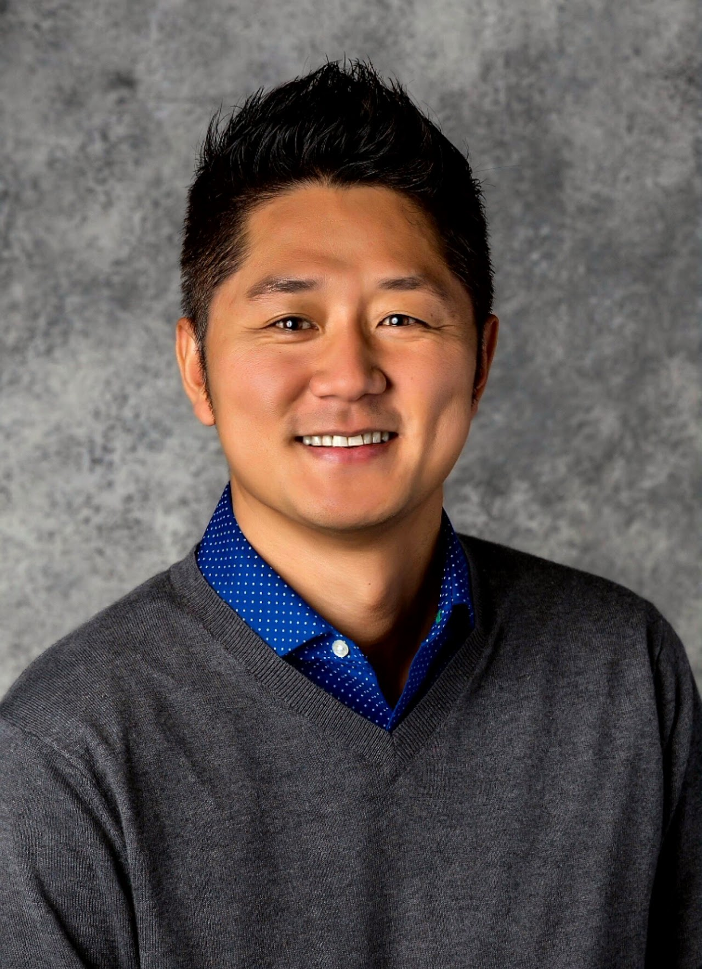
About PAID team
We are from the Psychometrics and Individual Differences (PAID) Lab in George Mason University
Zihao Jia
4th year PhD
Mina Son
3rd year PhD
Philseok Lee
PAID Lab advisor

Slide 3
The big picture
 | Empathy | Interview | Clarity | Fairness
Task type | Classification | Generation | Regression | Classification/ regression
Base model | Fine-tuned GPT3.5 | Fine-tuned GPT3.5 | Fine-tuned GPT3.5 | Fine-tuned GPT3.5
Final model (performance) | Few-shot GPT4 (0.145) | Few-shot GPT4 (0.109) | Fine-tuned DeBERTa (0.204) | Few-shot GPT4 (0.207)

Slide 4
empathy
Fine-tune DeBERTa or GPT3.5 turbo (failed)
Reasons: small sample size,
Unclear labels, extremely hard even for human (at least to me…)
Use pre-trained empathy/emotion model (failed)
Reasons: the target construct in the current data may not necessarily be the “empathy”.
GPT4 prompt engineering with thought process (worked)
Step 1: ask GPT4 to generate why this email did/didn’t demonstrate empathy.
Step 2: use the reasons generated from step 1 as the prompt. This can help GPT learning the underlying logic of previous labels.

Slide 5
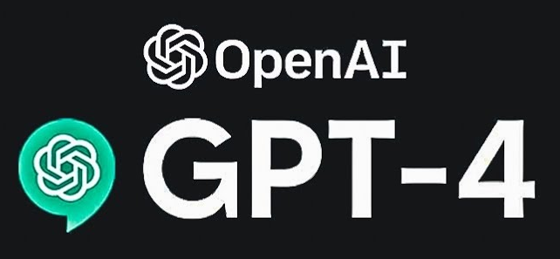
Example prompt User: Here is an email written to jonathan to provide some feedback to his work on the beta project ###email starts###{ds.Text[i]}###email ends###. Though jonathan did not do very well on the work, the writer still want to convey some empathy and understanding in this email to help jonathan get improved. Now you think this email did demostrate empathy, why? Provide a short answer. Assistant: yes, the email demonstrates empathy because… * Note: All cases in training set will be combined together as few-shot learning examples.

Slide 6
fairness
Similar idea as empathy (GPT4 prompt engineer) (worked)
Step 1: generate the reason why option 1/option 2 is more preferred.
Step 2: create few-shot learning examples with the generated reasons.
Also tried to create fairness scores with GPT then compare. (failed)

Slide 7
Example prompt User: I have two policies. Policy 1:[{ds_fairness.first_option[i]}]. Policy 2: [{ds_fairness.second_option[i]}] employees prefer the {ds_fairness.majority_vote[i]} one. What could be the reasons for that? Provide your answer Assistant: Employees might prefer the Diversity policy because…. * Note: All cases in training set will be combined together as few-shot learning examples.

Slide 8
Clarity
Fine-tuned DeBERTa-V3-base (worked)
Can use R or MSE as loss during training
Weight_decay = 0.1
Train/validation split on original training set.
Tried GPT4 (failed)
Tried fine-tuned GPT3.5 (failed)

Slide 9
Interview
GPT 4 – person centered (worked)
GPT 4 – question centered (worked)
Step 1: collect all questions from train/validation/testing set.
Step 2: collect all response to each question from all datasets.
Step 3: Use step 2 response as few-shot learning examples and generate the response to that question.
Difficult to predict job candidate’s specific experience
e.g., I met a women in business panel conference

Slide 10
Example prompt User: Respond to the last question using no more than 120 words. Keep the tone and personality reflected in the provided previous responses. Question: {ds_test['Q1'][i]} Response: {ds_test['R1'][i]} Question: {ds_test['Q2'][i]} Response: {ds_test['R2'][i]} Question: {ds_test['Q3'][i]} Response: {ds_test['R3'][i]} Question: {ds_test['Q4'][i]} Assistant: In a group project for my final year at university, I was tasked with leading the research component….

Slide 11
Discussion
Is personality important in the current data?
Meh, too hard for the model
Some takeaways
Pay to win (GPT)
Well, sometimes we can save some money (open-resource)
Avoid overfitting, try more parameter tunning
Think about difficulty, sample size before choosing a model.
Help the model to think as a human. You are ALWAYS smarter than LLM.

Slide 12
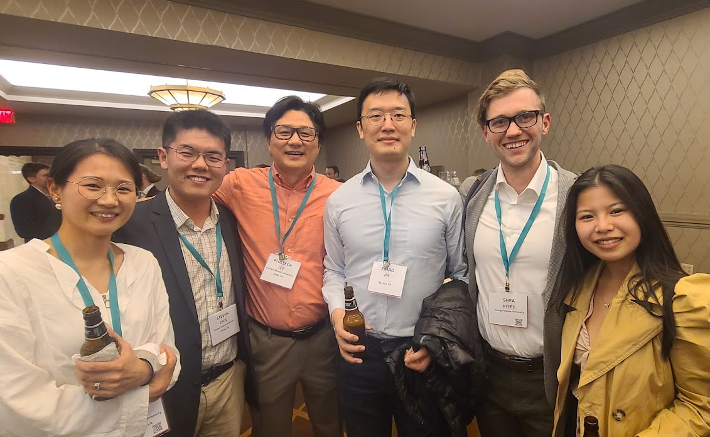
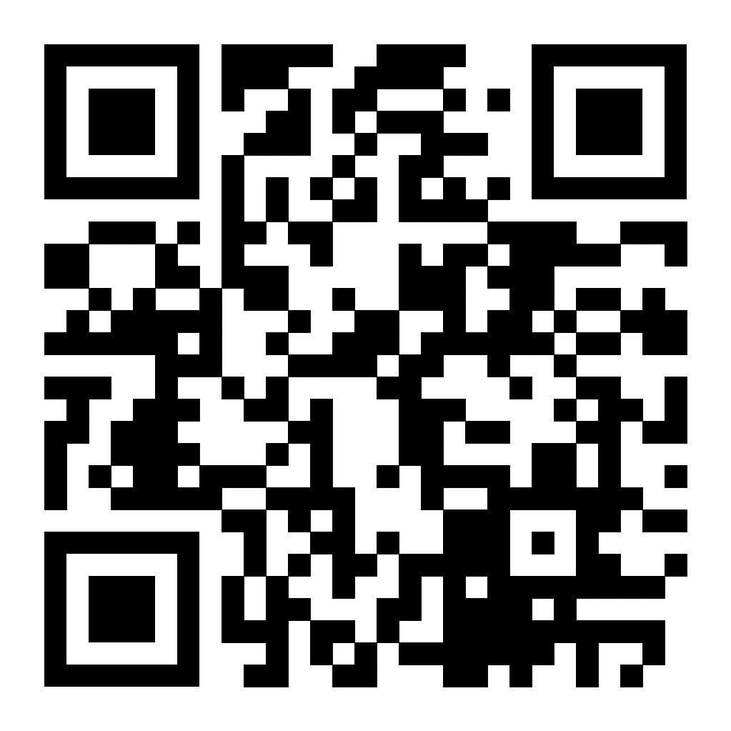
Thank you
For questions: zjia2@gmu.edu
------------------------------------------------------------------------
My NLP journey all begins with Phil, I wouldn’t be here without him
Mina is the best team member
We are looking for a new member(s)!
For details, check out our lab website! (QR)

